Slide 1
Entity Framework Core
EF Core Database First (Part 2)

Slide 2

Lesson Objectives
Entity Relationship
Basic of LINQ
Querying in Entity Framework Core
Eager Loading, Lazy Loading vs Explicit Loading

Slide 3
Entity Relationship
Section 1

Slide 4
Entity Relationship
EF Core is an ORM framework for .NET that enables developers to work with databases using object-oriented concepts.
EF Core uses navigation properties and annotations to define relationships between entities
The Entity Framework supports four types of relationships similar to the database.
One-to-One Relationship
One-to-Many Relationship
Many-to-Many Relationship
Self-Referencing Relationship

Slide 5
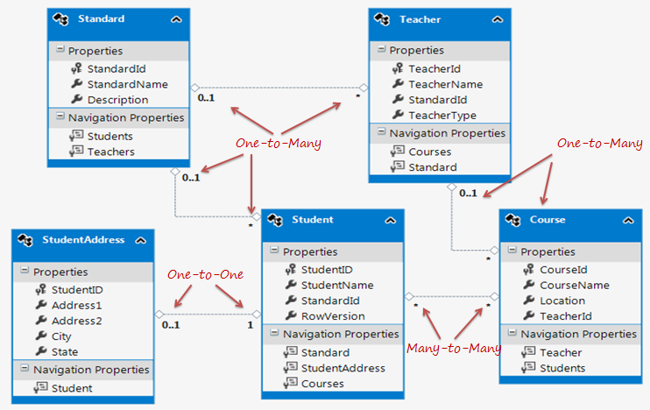
Entity Relationship

Slide 6
One-to-Many Relationship
One parent can have many children whereas a child can associate with only one parent
Example: The Standard and Teacher entities have a One-to-Many relationship
Standard can have many Teachers
Teacher can associate with only one Standard

Slide 7
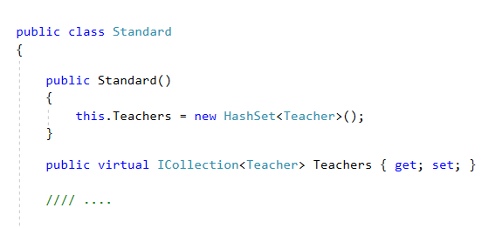
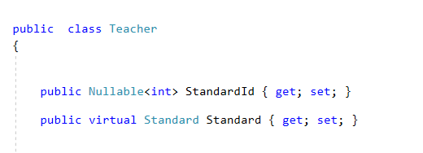
One-to-Many Relationship
The parent entity has the collection navigation property children
The child entity has a parent navigation property
The child entity also contains the foreign key to parent primary key

Slide 8
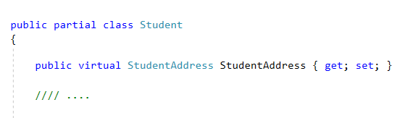
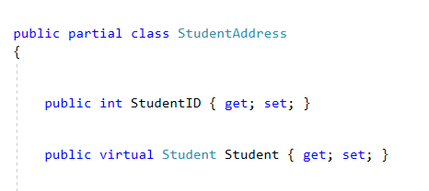
One-to-One Relationship
One entity can have one or zero entity in relationship
Example: One department has one director
Example: A student can have only one or zero addresses

Slide 9
Many-to-Many Relationship
One Product can appear in many Orders, and one Order can have many Products
One Student can enroll for many Courses and also, one Course can be taught to many Students.

Slide 10
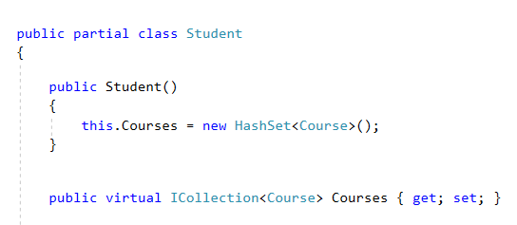
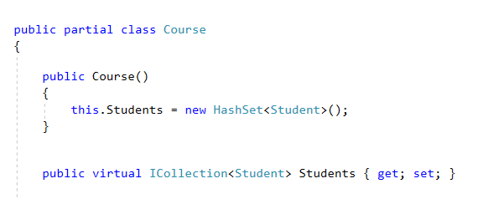
Many-to-Many Relationship
In SQL: break many-to-many relationship to 2 one-to-many relationships
Joining table only includes PKs of 2 tables
In EF: use 2 collection navigation properties for 2 entities

Slide 11
Self-Referencing Relationship
Similar to a Self-Referencing Relationship in a relational database, an entity can have a relationship with instances of the same entity type.
For example, an Employee entity can have a Manager navigation property that points to another Employee.

Slide 12
Basic of LINQ
Section 6

Slide 13

LINQ
LINQ (Language Integrated Query) is uniform query syntax in C# and VB.NET to retrieve data from different sources and formats.
LINQ queries return results as objects. It enables you to uses object-oriented approach on the result set and not to worry about transforming difference formats of results into objects.

Slide 14
Advantages of LINQ
Familiar language: Developers don’t have to learn a new query language for each type of data source or data format.
Less coding: It reduces the amount of code to be written as compared with a more traditional approach.

Slide 15
Advantages of LINQ
Readable code: LINQ makes the code more readable so other developers can easily understand and maintain it.
Standardized way of querying multiple data sources: The same LINQ syntax can be used to query multiple data sources.

Slide 16
Advantages of LINQ
Compile time safety of queries: It provides type checking of objects at compile time.
IntelliSense Support: LINQ provides IntelliSense for generic collections.
Shaping data: You can retrieve data in different shapes.

Slide 17
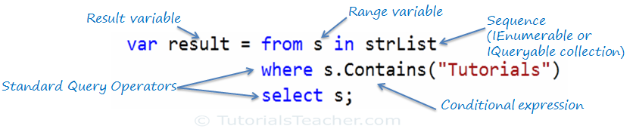
LINQ Query Syntax
Query syntax is similar to SQL (Structured Query Language) for the database.
It is defined within the C# or VB code.

Slide 18

LINQ Method Syntax
Method syntax (also known as fluent syntax) uses extension methods included in the Enumerable or Queryable static class,
It is similar to call the extension method of any class.

Slide 19
Standard Query Operators
Where
OrderBy/ThenBy
OrderByDescending/ThenByDescending
All/Any
Contains
…

Slide 20
Standard Query Operators
Average/Count/Max/Min/Sum/Distinct
Skip/SkipWhile
Take/TakeWhile
ToArray/ToList/ToDictionary
… and more

Slide 21
Querying in Entity Framework
Section 7

Slide 22
LINQ-to-Entities Query
Use LINQ for querying against DbSet. It will be converted to an SQL query.
EF API executes this SQL query
to the underlying database,
gets the flat result set,
converts it into appropriate entity objects and
returns it as a query result

Slide 23
Eager Loading
Is the process whereby a query for one type of entity also loads related entities as part of the query,
Don't need to execute a separate query for related entities.
Eager loading is achieved using the Include() method.

Slide 24
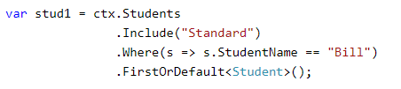
Eager Loading
Example: Gets all the students from the database along with its standards using the Include() method.

Slide 25
Lazy Loading
Is delaying the loading of related data, until specifically request for it.
Navigation property should be defined as public, virtual.
Context will NOT do lazy loading if the property is not defined as virtual.

Slide 26

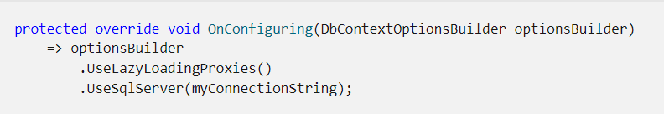
Lazy loading with proxies
The simplest way to use lazy-loading is by installing the Proxies package
After enabling it with a call to UseLazyLoadingProxies.
For example:

Slide 27
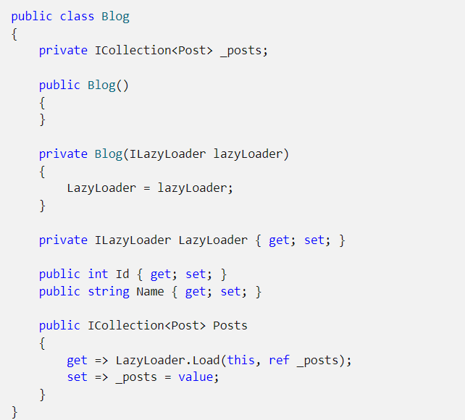
Lazy loading without proxies
For example:
Lazy-loading without proxies work by injecting the ILazyLoader service into an entity, as described in Entity Type Constructors.

Slide 28

Explicit Loading
To load the entities when lazy loading is disabled
By calling the Load method for the related entities.
Reference: to load single navigation property
Collection: to load collections

Slide 29
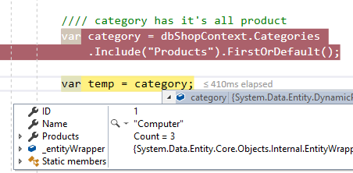
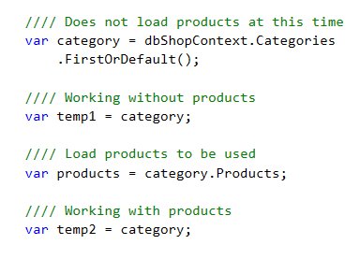
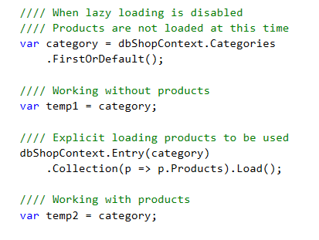
Comparison
Eager Loading
Lazy Loading
Explicit Loading
Always load for first time
Load for first time requested
Load when explicit call

Slide 30
When to use what
Use Eager Loading when the relations are not too much. Thus, Eager Loading is a good practice to reduce further queries on the Server.
Use Eager Loading when you are sure that you will be using related entities with the main entity everywhere.
Use Lazy Loading when you are using one-to-many collections.

Slide 31
When to use what
Use Lazy Loading when you are sure that you are not using related entities instantly.
When you have turned off Lazy Loading, use Explicit loading when you are not sure whether or not you will be using an entity beforehand.

Slide 32

Thank you

